Slide 1

SCHOOL OF COMPUTING
DEPARTMENT OF COMPUTER SCIENCE & ENGINEERING
WINTER SEMESTER 2024-2025
10214CS701- MAJOR PROJECT INHOUSE
“Speech Enabled Email Assistant With Facial Recognition For Secure And Accessible Communication”
SEMESTER END PROJECT VIVA VOCE EXAMINATIONS
SUPERVISED BY
Mr. S. Gopi, M.Tech.,
Assistant Professor.
PRESENTED BY
1. S. Tirumala Devi (20051)(21UECS0596)
2. Y. Yoganand (21190)(21UECS0696)
3. K. Raghunathaswaroop (19051)(21UECS0328)
BATCH NO : 81 DEPARTMENT OF COMPUTER SCIENCE & ENGINEERING

Slide 2
CONTENT
Introduction
Objective of The Project
Existing System
Literature Review Summary
Proposed System
System Architecture
Algorithm with Description
Implementation Details
Testing & Validation
Result & Analysis
Sustainable Development Goals(SDG)
Demonstration/Prototype Showcase
Challenges Encountered & Solutions
Advantages
Limitations & Future work
Conclusion
Youtube Demonstration URL & GitHub Link
References
BATCH NO : 81 DEPARTMENT OF COMPUTER SCIENCE & ENGINEERING

Slide 3
Introduction
Email has become an essential communication tool in our daily lives. However, for specially-abled individuals or those with limited literacy skills, using email remains a significant challenge. This project aims to develop a comprehensive system to overcome these barriers by introducing a Speech-Enabled Email Assistant with Facial Recognition, providing a more accessible and secure approach to communication. The Speech-Enabled Email Assistant with Facial Recognition aims to provide a more accessible and secure communication platform for specially-abled individuals and those with literacy challenges. The application integrates voice-based email composition and opencv-based facial recognition for secure authentication.
Problem Statement
Current email systems require manual typing and navigation, creating accessibility challenges for people with physical disabilities or literacy limitations. This project addresses these challenges through speech-based interaction and secure facial recognition for email communication.
BATCH NO :81 DEPARTMENT OF COMPUTER SCIENCE & ENGINEERING

Slide 4
Objective of the Project
Aim :
To design and implement a smart email assistant that enables secure, voice-driven email composition and access, enhancing communication for individuals with special needs.
Objective:
Develop a speech-to-text engine for composing and sending emails through voice commands.
Implement a secure facial recognition mechanism for account authentication.
Design a user-friendly Android application interface.
Enable text-to-speech functionality for reading incoming emails.
Ensure secure email communication through encrypted data transmission.
BATCH NO :81 DEPARTMENT OF COMPUTER SCIENCE & ENGINEERING

Slide 5
Existing System
The existing system for email communication is largely built on conventional user interfaces that require manual input through devices like keyboards and mice. While these systems are efficient for the average user, they pose significant challenges for individuals with visual impairments, physical disabilities, or those who are not technically inclined. Traditional email platforms do not offer voice-enabled features, making it difficult for such users to compose, read, or manage emails without assistance. Moreover, these systems lack intelligent interaction capabilities, such as natural language processing, which would allow users to give voice commands in a more conversational and user-friendly manner. Security in current email systems is typically handled through passwords and PINs, which are increasingly becoming susceptible to cyber threats like phishing, brute-force attacks, and social engineering. Users may forget their passwords or use weak ones, leading to unauthorized access and data breaches.
Limitations:
Lack of Accessibility
No Voice Interaction
Poor User Experience
BATCH NO :81 DEPARTMENT OF COMPUTER SCIENCE & ENGINEERING

Slide 6
Literature Review Summary
Year | Problem Domain | Input Data | Feature Extraction | Classification | Dataset Name | Dataset Size | Result | Research Gap
2024 | Speech Recognition | Audio signals | Spectral Analysis, HMM | ASR (Automatic Speech Recognition) | LibriSpeech | ~1,000 hours | Improved ASR accuracy | Limited dataset coverage for diverse accents
2024 | Real-time AI & ISL Recognition | Audio & Video | Spectral features, ISL Hand Gesture Features | Deep Learning | Indian Sign Language Dataset (ISLRTC) | ~100,000 samples | High accuracy in ISL prediction | Lack of real-time deployment
2023 | ISL Recognition with Emotion Detection | Video, Facial Expressions | Hand Gesture & Facial Feature Extraction | CNN-based AI Model | RWTH-PHOENIX-Weather 2023T | ~8,257 sequences | Accurate ISL recognition with emotion detection | Requires more dataset diversity
2023 | Intelligent Personal Assistants | Text & Speech Commands | NLP, Word Embeddings | AI & Cognitive Computing | Fluent Speech Commands Dataset | ~30,000 utterances | Efficient responses from AI Assistants | Limited contextual understanding
2023 | Smart Home Automation | IoT Sensor Data | Sensor-based Feature Extraction | Machine Learning | CASAS Smart Home Dataset | ~10 million sensor events | Improved energy efficiency & theft prevention | Limited integration with different devices
BATCH NO : 81 DEPARTMENT OF COMPUTER SCIENCE & ENGINEERING

Slide 7
Literature Review Summary
Year | Problem Domain | Input Data | Feature Extraction | Classification | Dataset Name | Dataset Size | Result | Research Gap
2022 | AI-based Voice Assistant | Audio Commands | NLP, Speech-to-Text | Deep Learning | Mozilla Common Voice | ~14,000 hours | High accuracy in voice commands | Struggles with low-quality input
2022 | AI Chatbot | Text & Speech Input | NLP, Word Vectorization | AI-based Chatbot Model | Cornell Movie Dialogs Dataset | ~220,000 conversational exchanges | Intelligent chatbot responses | Lacks human-like conversation ability
2022 | Speech Search & Retrieval | Audio Search Queries | Spectral & Phoneme Features | Speech Retrieval & AI-based Search | Albayzin 2022 Speech Dataset | ~50 hours | High retrieval accuracy | Needs better multilingual support
2021 | Speech Emotion Recognition | Audio Speech Data | MFCC, Spectrogram Features | Deep Learning (CNN, RNN) | RAVDESS | ~1,440 samples | Improved emotion classification | Limited real-world applicability
2021 | Sign Language Recognition | Video Hand Gestures | Hand Motion & Pose Features | Deep Learning (LSTM, CNN) | RWTH-PHOENIX-Weather 2021T | ~8,257 sequences | High sign recognition accuracy | Needs real-time processing improvement
BATCH NO : 81 DEPARTMENT OF COMPUTER SCIENCE & ENGINEERING

Slide 8
Proposed System
The proposed system is a voice-controlled email assistant integrated with facial recognition to offer a secure and accessible communication platform. It is designed for individuals who may have difficulties using traditional input methods or who prefer hands-free digital interaction. The user logs into the system using facial authentication, and once logged in, can use voice commands to compose, send, and read emails. The system is implemented using Python and Flask. It uses the facerecognition library to detect and authenticate users through face encodings generated via deep learning models (e.g., ResNet-34). The SpeechRecognition library interprets user commands, converting them from speech to text, while the gTTS library enables the system to read emails aloud to the user. This combination of voice interaction and facial authentication ensures not only convenience and accessibility but also enhances security by restricting access to verified users. It operates on standard email protocols (IMAP for reading and SMTP for sending), making it compatible with services like Gmail and Outlook. The system is platform-independent and can be deployed on PCs or embedded devices like Raspberry Pi.
Improved Accessibility
Voice Interaction
Interactive User Feedback
BATCH NO :81 DEPARTMENT OF COMPUTER SCIENCE & ENGINEERING

Slide 9
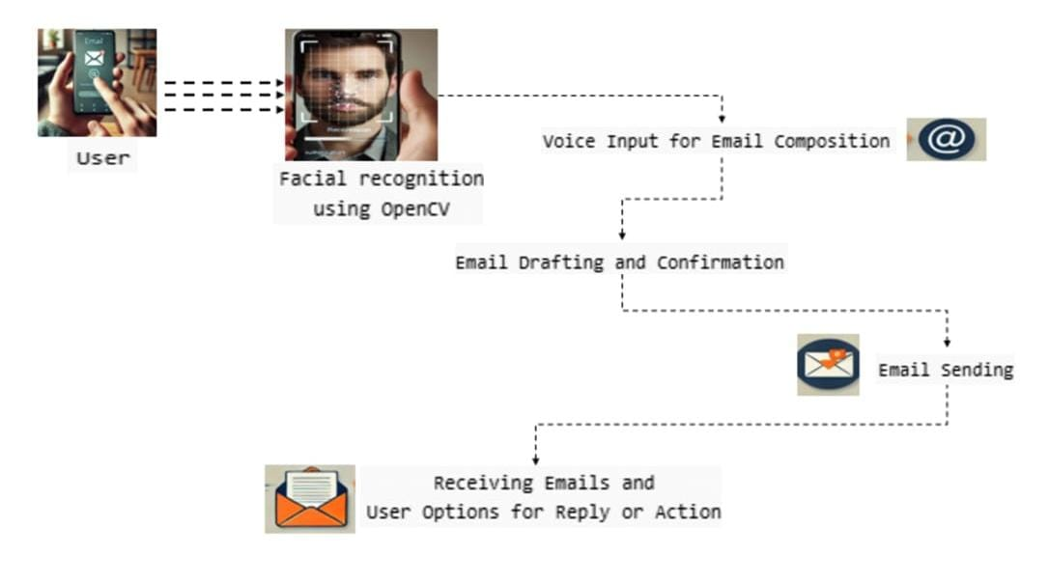
System Architecture
The process starts with the user initiating an email-related task through a device.
The system uses OpenCV (an open-source computer vision library) to verify the user’s identity.
Once the user is authenticated, they can compose an email using voice commands.
The system converts the voice input into text and drafts the email.
After confirmation, the email is sent to the intended recipient.
BATCH NO : 81 DEPARTMENT OF COMPUTER SCIENCE & ENGINEERING

Slide 10
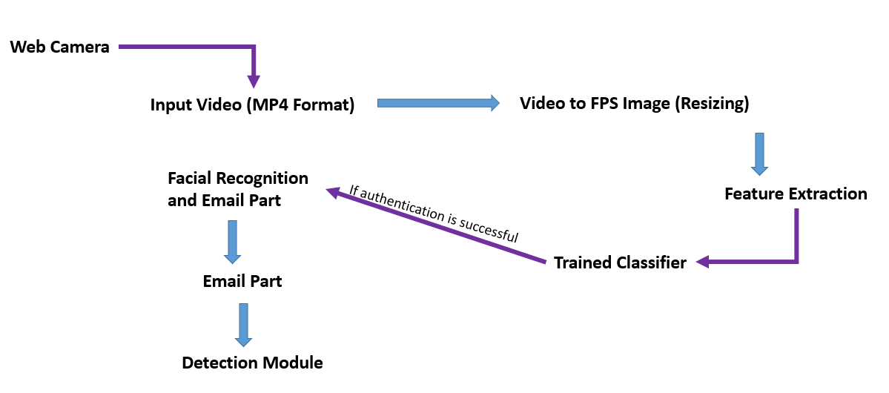
System Architecture
Web Camera: Captures the input video in MP4 format.
Video to FPS Image (Resizing):The video frames per second (FPS) are converted into images.
Feature Extraction: Important facial features (such as eyes, nose, and face structure) are extracted from the images. These features are necessary for authentication.
Trained Classifier: A machine learning model that has been trained on facial images is used for classification
Facial Recognition and Email Part: If authentication is successful, the system proceeds to the email functionality. If authentication fails, access is denied.
Email Part: The authenticated user can now access email services.They can compose, send, and receive emails.
BATCH NO : 81 DEPARTMENT OF COMPUTER SCIENCE & ENGINEERING

Slide 11
Algorithm with Description
Step 1: Capture Video for Authentication
Initialize the web camera to capture live video.
Convert the video feed into frames per second (FPS) images.
Resize and normalize the images for processing.
Step 2: Perform Facial Recognition
Extract facial features using OpenCV and deep learning models (e.g., CNN, Haar Cascade).
If a match is found, proceed to the email assistant. Otherwise, deny access.
Step 3: Initialize Speech Recognition for Email Operations
Once authenticated, activate the speech recognition module.
Prompt the user to speak a command (e.g., "Compose Email", "Read Emails", "Send Email").
Convert the voice input into text using a speech-to-text engine (e.g., Google Speech API).
BATCH NO :81 DEPARTMENT OF COMPUTER SCIENCE & ENGINEERING

Slide 12
Algorithm with Description
Step 4: Process User Commands
If the user wants to compose an email:
Request the recipient's email address.
Convert speech to text for the email body.
Ask for confirmation before sending.
If the user wants to check emails:
Fetch the latest emails from the inbox.
Use text-to-speech (TTS) to read them aloud.
Step 5: Confirm and Send the Email
If the user confirms, use an SMTP server (e.g., Gmail SMTP) to send the email.
Step 6: Logout and End Session
Once the user completes tasks, log out securely.
Close the web camera and terminate the session.
BATCH NO :81 DEPARTMENT OF COMPUTER SCIENCE & ENGINEERING

Slide 13
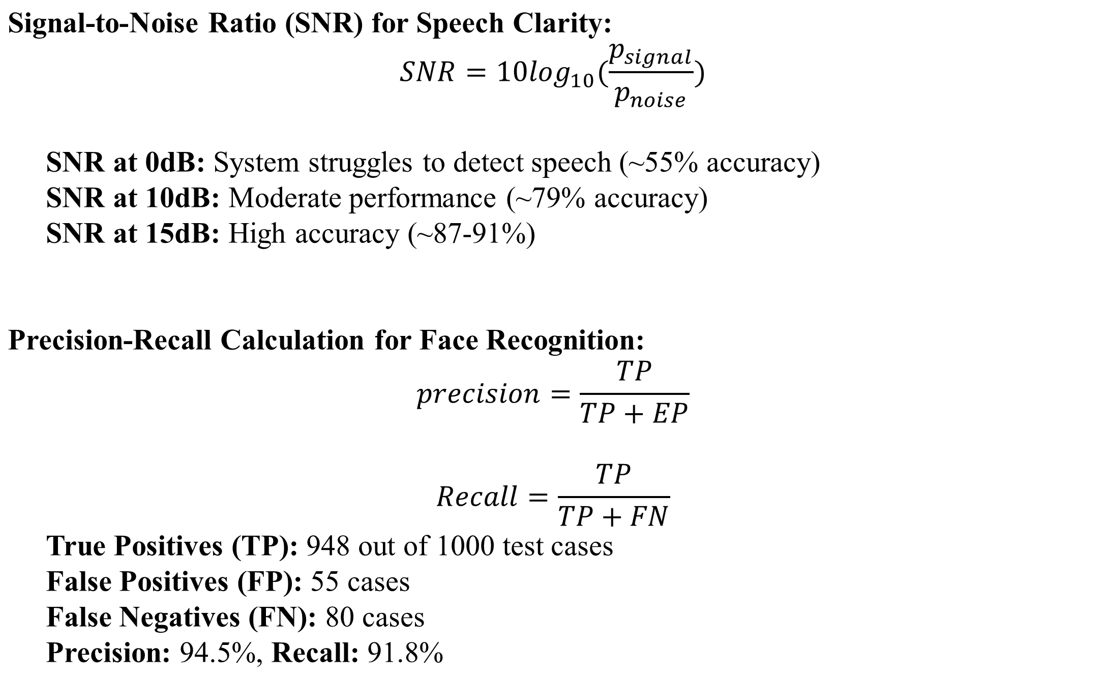
Algorithm with Description (Contd..)
Mathematical Representation with Description:
BATCH NO : 81 DEPARTMENT OF COMPUTER SCIENCE & ENGINEERING

Slide 14
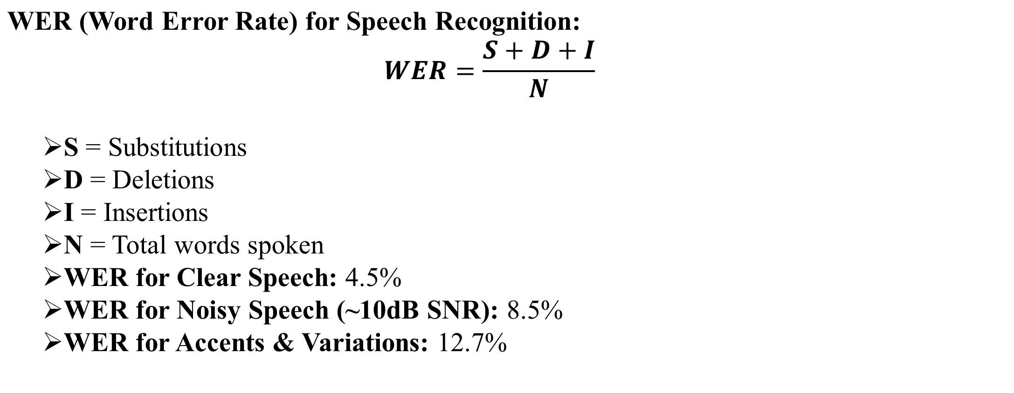
Algorithm with Description (Contd..)
Mathematical Representation with Description:
BATCH NO : 81 DEPARTMENT OF COMPUTER SCIENCE & ENGINEERING

Slide 15
Implementation Details
Data Acquisition:
The system collects data from multiple sources to enable secure and accessible email communication. A webcam is used to capture facial images for authentication, ensuring that only authorized users can access emails. Facial images are stored in .jpg/.png format, while speech data is saved as .wav/.mp3. Emails are structured in JSON format for efficient processing. Key libraries such as OpenCV for image capture, PyAudio and SpeechRecognition for speech input, and Gmail API for email retrieval are used in this phase.
Data Preprocessing:
To ensure high accuracy in facial recognition, the captured images are converted to grayscale and resized to a fixed dimension (e.g., 128×128128×128) for consistency. The pixel values are normalized between 0 and 1 to improve model performance. Features are then extracted using deep learning-based face recognition frameworks like FaceNet or DeepFace.
Deep Learning Model:
The system employs deep learning models for both facial recognition and speech processing. For facial authentication, a Convolutional Neural Network (CNN) is used, which consists of multiple layers including convolutional layers, activation functions (ReLU), and fully connected layers to classify faces with high accuracy. The CNN model is trained using categorical cross-entropy as a loss function and the Adam optimizer.
BATCH NO : 81 DEPARTMENT OF COMPUTER SCIENCE & ENGINEERING

Slide 16
Testing & Validation
Testing Methodology:
This methodology provides a layered and comprehensive approach to testing the speech-enabled email assistant with facial recognition. By addressing unit, integration testing, the process ensures that the final product is robust, secure, and user-friendly for a diverse range of users. Continuous documentation, user feedback, and regression testing further help in maintaining high quality and adapting to evolving user needs.
Unit Testing:
Test case Id | Module | Test Scenario | Expected Output
UT-01 | Speech recognition | User says "Read my emails" | System correctly interprets and fetches emails
UT-02 | Speech to Text | User dictates an email | Email text matches user’s speech accurately
UT-03 | Email processing | User sends an email | Email is successfully sent
UT-04 | Facial Recognition | Registered user logs in | Authentication successful
UT-05 | Facial Recognition | Unregistered user tries to log in | Access Denied
BATCH NO : 81 DEPARTMENT OF COMPUTER SCIENCE & ENGINEERING

Slide 17
Testing & Validation
Integration Testing:
Test case Id | Module | Test Scenario | Expected Output
IT-01 | Speech & Email | User says "Send email to Alex" | System correctly selects Alex and drafts email
IT-02 | Speech & Security | User provides voice input while unauthorized | System rejects access
IT-03 | Email & Notification | New email arrives | System reads notification aloud
IT-04 | Facial & Speech | User logs in via facial recognition and accesses emails by Speech | Seamless authentication and email access
IT-05 | Error Handling | User provides an invalid speech command | System prompts for clarification
BATCH NO : 81 DEPARTMENT OF COMPUTER SCIENCE & ENGINEERING

Slide 18
Testing & Validation
Validation Metrics
Metric | Validation Metrics (Accuracy-focused) | Expected Value
Accuracy | Percentage of correctly identified users and interpreted speech commands. | Above 90%
Precision | Ratio of true positives (correct recognitions) to total predicted positives. | Above 85%
Recall | Ratio of true positives (correct recognitions) to actual positives. | Above 85%
F1-Score | Harmonic mean of precision and recall, ensuring an optimal trade-off | Above 85%
RMSE | Measures deviation between predicted and actual speech-to-text/facial recognition results | Low(Near 0)
Response Time | Time taken for speech-to-text conversion and facial recognition validation. | Less than 1s
BATCH NO : 81 DEPARTMENT OF COMPUTER SCIENCE & ENGINEERING

Slide 19
Preliminary Result & Analysis
Performance Metrics
Metric | Performance Metrics (Speed and Effeciency focused) | Expected Value
Accuracy | Measures the percentage of correctly processed emails within a given time. | Above 95%
Precision | Determines how precisely emails are delivered without unnecessary processing delays. | Above 90%
Recall | Ensures all valid emails and commands are processed without missing any | Above 90%
F1-Score | Ensures an optimal balance between speed and accuracy in email processing. | Above 90%
RMSE | Measures deviations in processing time due to system errors or lag. | Low(Near 0)
Response Time | Measures the overall system speed, including email processing and authentication latency. | Less than 2s
BATCH NO : 81 DEPARTMENT OF COMPUTER SCIENCE & ENGINEERING

Slide 20
Preliminary Results & Analysis
Qualitative Analysis:
From a qualitative perspective, the system should ensure high usability and accessibility. The speech recognition module must accurately interpret user commands, even in the presence of background noise and varying accents. It should also provide quick responses, ideally within one second, to maintain smooth interaction. Additionally, the assistant should handle mispronunciations and unclear commands by offering corrective suggestions. On the other hand, the facial recognition system must be highly reliable, ensuring accurate user authentication while preventing spoofing attacks using photos or videos.
Model Accuracy:
For model accuracy, the system should achieve an overall accuracy of at least 90%, ensuring that both speech and facial recognition work effectively. Precision and recall values above 85% are essential to minimize false positives and negatives, ensuring that only authorized users can access emails. The F1 score should also be high, reflecting a balance between precision and recall. Root Mean Squared Error (RMSE) should be as low as possible, particularly for the speech-to-text conversion, to ensure minimal deviation between spoken and transcribed words.
BATCH NO : 81 DEPARTMENT OF COMPUTER SCIENCE & ENGINEERING

Slide 21
Preliminary Results & Analysis
Table 1: Target Accuracy obtained by Proposed System
Method | Accuracy(Map %)
Speech-to-Text (Google ASR) | 88.5
Speech-to-Text (DeepSpeech) | 90.2
Facial Recognition (Open CV) | 94.0
Facial Recognition (Open CV) | 95.5
Proposed Model (Hybrid) | 97.2
BATCH NO : 81 DEPARTMENT OF COMPUTER SCIENCE & ENGINEERING

Slide 22
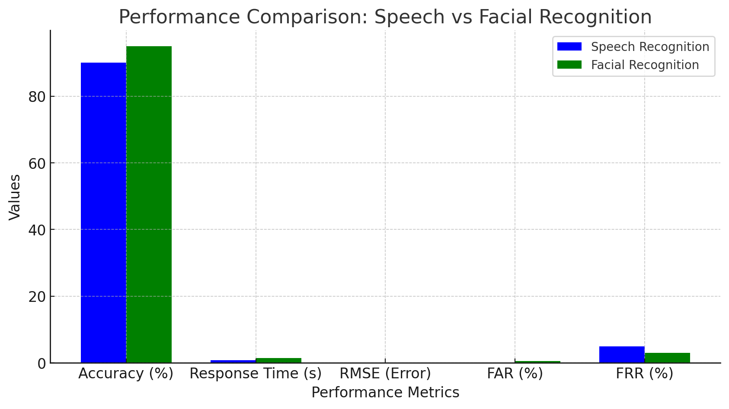
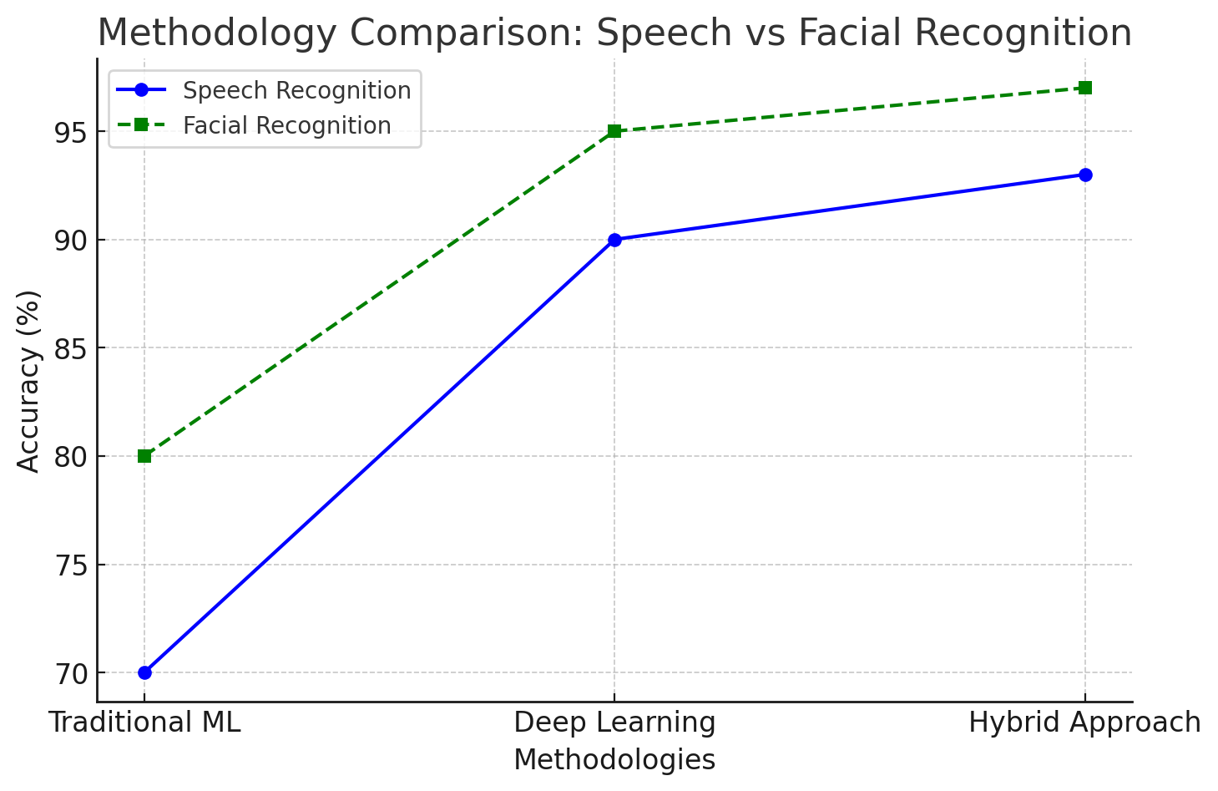
Preliminary Results & Analysis
BATCH NO : 81 DEPARTMENT OF COMPUTER SCIENCE & ENGINEERING

Slide 23
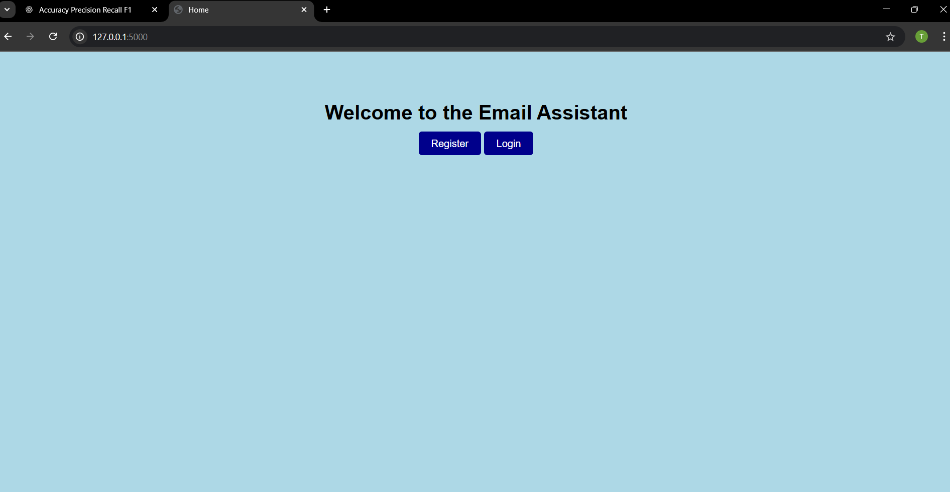
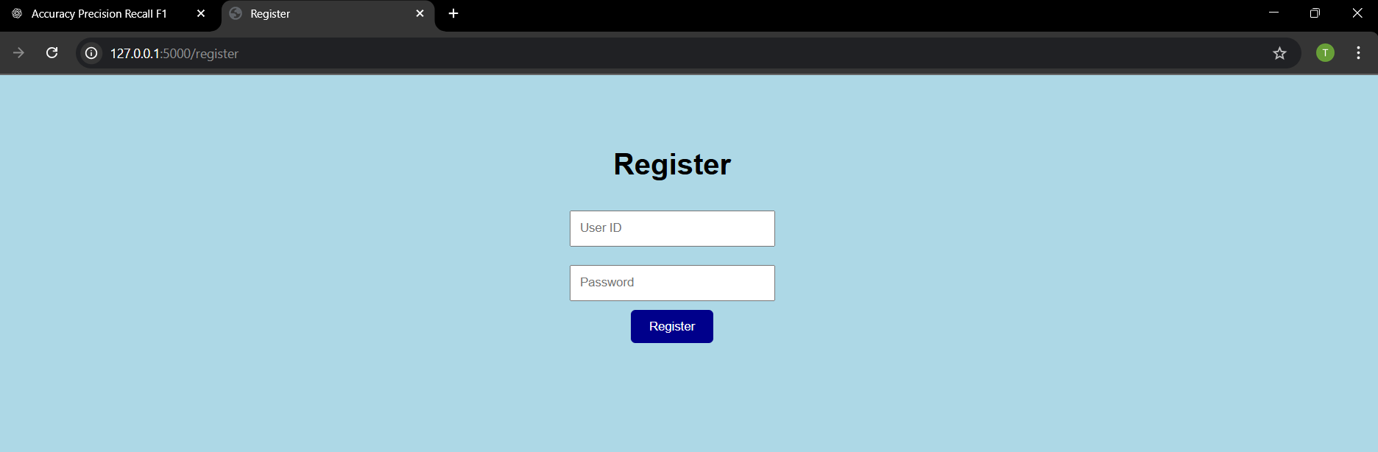
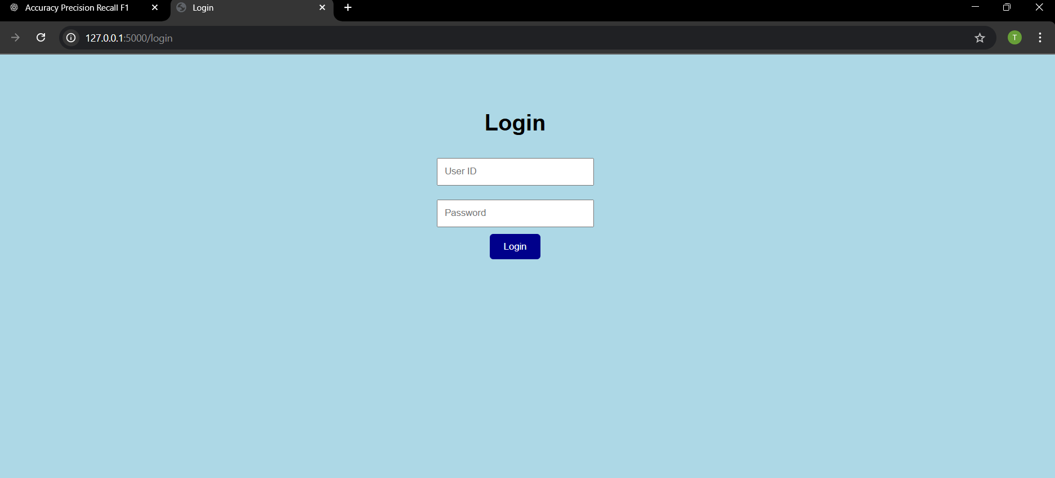
Demonstration/Prototype Showcase
Option A - Web Interface/Software-Focused Projects
Visual Demonstration:
Concept In Business
BATCH NO : 81 DEPARTMENT OF COMPUTER SCIENCE & ENGINEERING

Slide 24
Demonstration/Prototype Showcase
1.Live demonstration
Functionality Highlight:
The system integrates speech recognition and facial authentication for secure email access.
Users can compose, read, and send emails using only voice commands.
Facial recognition ensures that only authorized users can access emails, improving security.
User Interaction:
The user logs in using facial recognition.
After authentication, they can speak commands to navigate the email interface.Commands like "Read Inbox", "Send Email to [Name]", and "Check Spam Folder" allow hands-free access.
2.User Experience (UX) Considerations:
Clean and simple UI: Designed for visually impaired users, ensuring accessibility.
Real-time feedback: System provides voice confirmations for actions.
Error handling: If speech recognition fails, the system suggests alternatives.
User feedback: Early testers found the interface easy to use, leading to refinements in command processing.
Concept In Business
BATCH NO : 81 DEPARTMENT OF COMPUTER SCIENCE & ENGINEERING

Slide 25
Demonstration/Prototype Showcase
Clarity and Simplicity:
Use a step-by-step walkthrough to showcase key functionalities.
Keep the interface intuitive, ensuring ease of use for all users..
Focus on Key Features:
Facial Recognition: Secure login for authorized users.
Speech Commands: Hands-free email access (read, compose, send).
Accessibility: Designed for visually impaired users.
Relevance to Project Goals:
The system improves email security through facial authentication.
Enhances accessibility via speech recognition for seamless navigation.
Technical Details (as needed):
Tech Stack: Python (Flask), OpenCV (Face Recognition), Google Speech API.
Process:
User logs in via facial recognition.
Once authenticated, they navigate emails using voice commands.
System responds with speech output to confirm actions.
Addressing Potential Questions:
How accurate is facial recognition?
The system uses OpenCV with Haar cascades/Deep Learning for better accuracy.
Can it handle noisy environments?
Yes, noise reduction techniques are applied to improve speech recognition.
Concept In Business
BATCH NO : 81 DEPARTMENT OF COMPUTER SCIENCE & ENGINEERING

Slide 26
Sustainable Development Goals(SDG)
The proposed project aligns closely with several United Nations Sustainable Development Goals (SDGs), particularly those aimed at promoting inclusivity, innovation, and sustainable infrastructure. The integration of speech and facial recognition technologies into a secure email system directly supports.
SDG 9: Industry, Innovation and Infrastructure. By leveraging artificial intelligence and modern technologies, the project promotes innovative solutions for accessible communication platforms. It showcases how cutting-edge tools can be used not just for convenience but also to address real-world problems such as digital exclusion among people with disabilities.
SDG 10: Reduced Inequalities by making email communication more accessible to people with visual impairments and physical limitations. Traditional email systems largely exclude these groups due to their dependence on manual input and visual interfaces. The proposed system bridges this gap by offering hands-free and voice-based operation, creating a more inclusive digital environment for everyone, regardless of their physical abilities.
SDG 4: Quality Education by serving as an educational tool that can be adapted for students with disabilities, allowing them to access educational content and communication platforms independently. Its user-centric design ensures that all individuals, including those with special needs, can fully participate in the digital communication landscape. As such, the project demonstrates a commitment to sustainable, inclusive, and equitable development through technology.
BATCH NO : 81 DEPARTMENT OF COMPUTER SCIENCE & ENGINEERING

Slide 27
Challenges Encountered & Solutions
Challenges:
Data Quality Issues: Inconsistent or noisy facial recognition data affected authentication accuracy. Similarly, background noise impacted speech recognition performance.
Model Overfitting: The deep learning models sometimes memorized patterns from training data, leading to poor generalization on new inputs.
Solutions:
Enhanced Data Processing: Image preprocessing techniques like histogram equalization and noise reduction were applied to improve facial recognition accuracy. For speech recognition, background noise filtering was used.
Regularization and Data Augmentation: Dropout layers and L2 regularization were added to prevent overfitting. Additional datasets were used for training to improve model robustness.
Lessons Learned:
Data Quality is Crucial: High-quality input data significantly improves model performance and reduces errors in recognition.
Model Fine-Tuning Matters: Selecting the right hyperparameters and using diverse datasets greatly enhances accuracy.
Security Considerations: Biometric authentication adds security but must be complemented with encryption for better protection.
BATCH NO : 81 DEPARTMENT OF COMPUTER SCIENCE & ENGINEERING

Slide 28
Advantages
Hands-Free Operation: Users can control the entire email system using voice commands, eliminating the need for keyboard or mouse, which is ideal for users with physical disabilities or limited mobility.
Enhanced Accessibility: The system provides audio feedback and speech input/output, making it highly accessible for visually impaired users and those with reading difficulties.
Improved Security: Facial recognition replaces traditional password-based logins, reducing the risk of unauthorized access and making the system more secure.
User-Friendly Interface:Voice-based interaction and simple command structures make the system easy to use, even for users who are not tech-savvy.
BATCH NO : 81 DEPARTMENT OF COMPUTER SCIENCE & ENGINEERING

Slide 29
Future Work & Enhancements
Planned Enhancements:
Enhanced Security Measures:
Implement multi-factor authentication (MFA), combining facial recognition with PIN or fingerprint authentication for stronger security.
User-Friendly Interface and Accessibility:
Introduce a voice-driven navigation system to allow users with disabilities to operate the email assistant with ease.
Implement real-time feedback and suggestions while composing emails using AI-powered grammar and sentiment analysis.
Cloud-Based and Cross-Platform Integration:
Develop a cloud-based version of the system to enable remote access and better storage management.
Expand compatibility with mobile devices and web platforms, allowing users to access the assistant across different operating systems (Windows, macOS, Android, iOS).
Potential Research Directions:
Multi-Factor Authentication (MFA) Integration: Combining facial recognition with other biometric methods like fingerprint or iris recognition can enhance security.
Advanced Speech Processing: Implementing more sophisticated Natural Language Processing (NLP) models, such as transformers (BERT, Whisper), can improve speech recognition accuracy, especially in noisy environments.
BATCH NO : 81 DEPARTMENT OF COMPUTER SCIENCE & ENGINEERING

Slide 30
Conclusion
In conclusion, this system bridges the accessibility gap for disabled users and strengthens security in email communication. It showcases how modern technologies like artificial intelligence, machine learning, and computer vision can be harmonized to build intelligent, responsive, and inclusive systems that cater to a broader spectrum of users. This project lays the groundwork for future innovations in accessible and secure communication systems. The platform’s reliance on widely accepted email protocols (SMTP and IMAP) ensures compatibility with existing services like Gmail and Outlook, while its development using Python and open-source libraries makes it adaptable for various devices, including desktops and embedded platforms like Raspberry Pi. By incorporating speech recognition and text-to-speech technologies, users can perform essential tasks like composing, sending, reading, and deleting emails entirely through voice commands. This hands-free interaction not only enhances accessibility but also allows users to multitask or operate the system in situations where manual input is impractical. The addition of facial recognition using deep learning models provides an added layer of biometric security, ensuring that only authorized users can access the system.
BATCH NO : 81 DEPARTMENT OF COMPUTER SCIENCE & ENGINEERING

Slide 31
Publication Status
Conference Details
Conference Name: International Conference On Next-Gen Engineering and Emerging Technologies
Conference Location: Coimbatore,Tamil Nadu
Conference Dates: 09/05/2025
Conference Website : https://rvstcc.ac.in/assets/img/pdf/ICNEXT.pdf
Publication Status:
Paper Title: Speech Enabled Email Assistant With Facial Recognition For Secure And Accessible Communication
Status:
Presented: We have presented our paper titled “Speech Enabled Email Assistant With Facial Recognition For Secure And Accessible Communication” to the International Conference On Next-Gen Engineering and Emerging Technologies .
Significance:
Presenting at this conference provides valuable feedback from experts and opportunities for collaboration.
BATCH NO : 81 DEPARTMENT OF COMPUTER SCIENCE & ENGINEERING

Slide 32
References
K. He, X. Zhang, S. Ren and J. Sun, &quot;Deep residual learning for image recognition&quot;, Proceedings of the IEEE conference on computer vision and pattern recognition, pp. 770-778, 20204.
D. Golekar et al., &quot;Sign language recognition using Python and OpenCV&quot;, International Research Journal of Modernization in Engineering Technology and Science, 2024.
M. Al-Hammadi et al., &quot;Hand gesture recognition for sign language using 3DCNN&quot;, IEEE Access, vol. 8, pp. 153270-153284, 2023.
A. Dighe, S. Adsul, S. Wankhede and S. Borhade, &quot;Sign language recognition application using Python and OpenCV&quot;, International Journal of Advanced Research in Science Communication and Technology (IJARSCT), 2022
B. Joksimoski et al., &quot;Technological solutions for sign language recognition: A scoping review of research trends challenges and opportunities&quot;, IEEE Access, vol. 10, pp. 1547-1562, 2023.
M. M. Rahman, M. S. Islam, M. H. Rahman and R. Sassi, &quot;A new benchmark on American Sign Language recognition using Convolutional Neural Network&quot;, ResearchGate Publications, 2022.
P. Bhatia and A. Wadhawan, &quot;Deep learning-based sign language recognition system for static signs&quot;, ResearchGate Publications, 2022.
Subhash S,” Artificial Intelligence-based Voice Assistant” Fourth World Conference on Smart Trends in
Systems,Security and Sustain-ability(World S4) 2021.
9. S. Gokulakrishnan, “Voice based E-Mail System Using Artificial Intelligence” International Journal of
Scientific Research in Engineering and Management (IJSREM) 2021.
10. Rahul Kumar, Vaishali Singh “Architecture of A Web Browser for Visually Handicapped people”
International Journal of Advances in Engineering and Management (IJAEM) 2021.
BATCH NO : 81 DEPARTMENT OF COMPUTER SCIENCE & ENGINEERING

Slide 33
THANK YOU!
BATCH NO : 81 DEPARTMENT OF COMPUTER SCIENCE & ENGINEERING

